Slide 1
Out of the Fire
Studio Fire at the Van Wyks
November , 2019

Slide 2
Catastrophic Loss
Total loss of building
Hundreds of clay pieces and art works
180 frames beyond repair were trashed
500 books, collected over 45 yrs
35 paintings and canvases
Shelving, tools, and equipment

Slide 3
Before and After

Slide 4
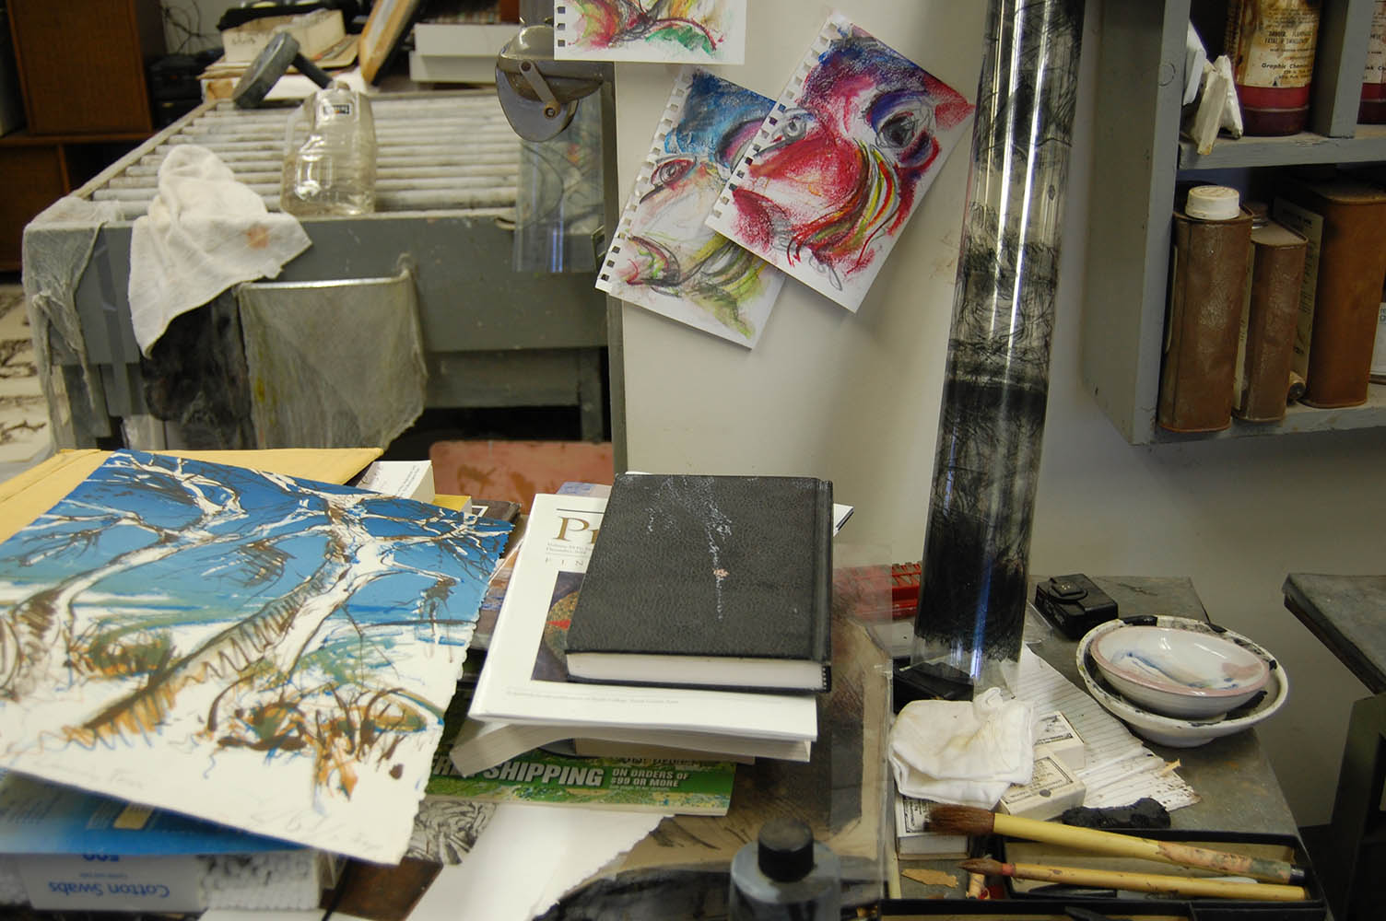
Before and After

Slide 6
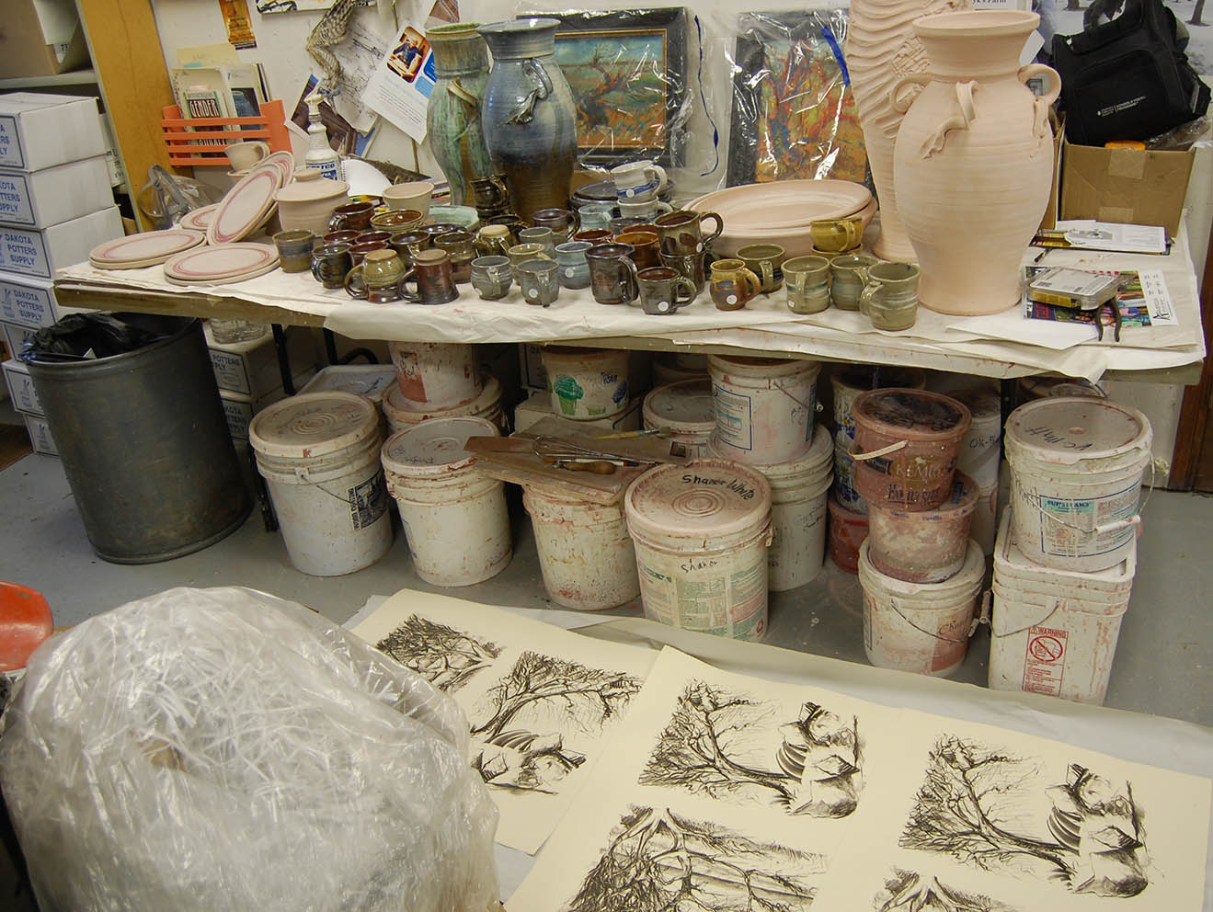
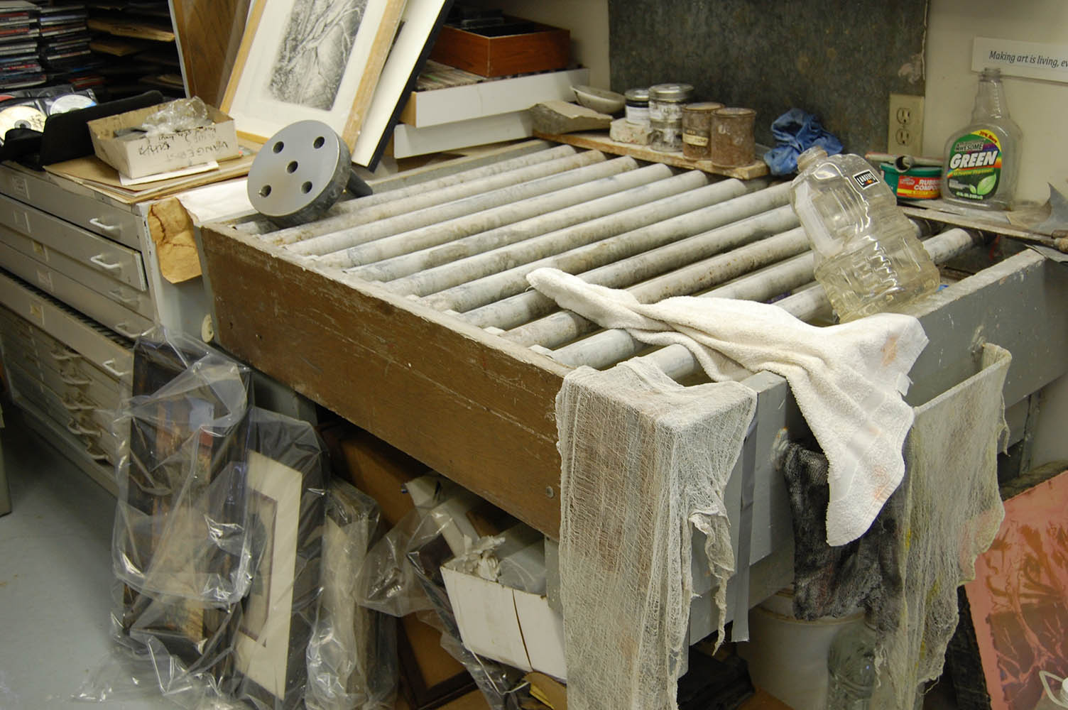

Slide 9
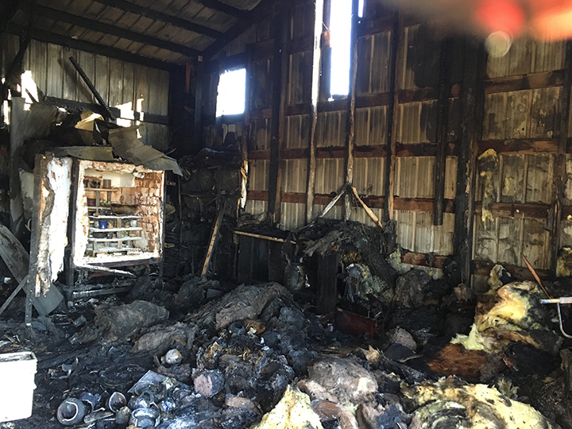

Slide 10
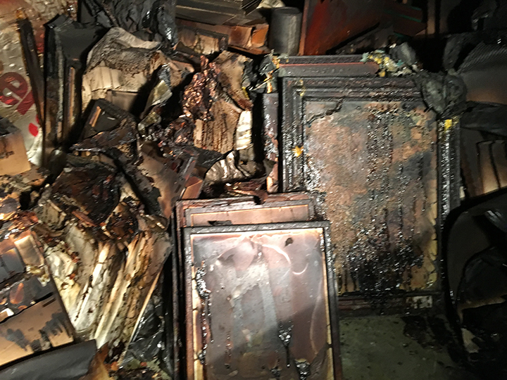

Slide 12
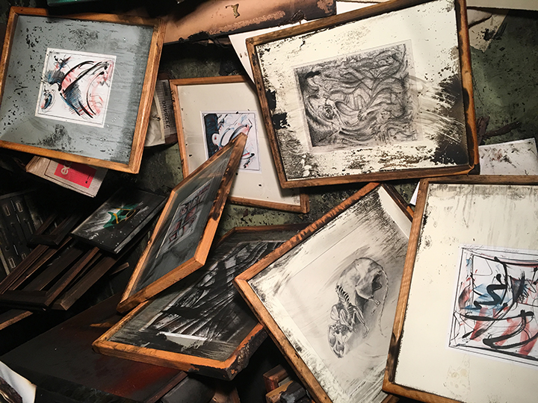

Slide 13
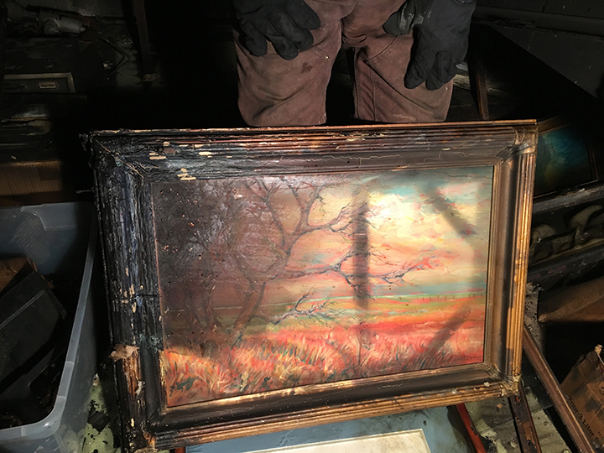
By the Creek, oil painting, 2017 – reproductions were printed

Slide 14
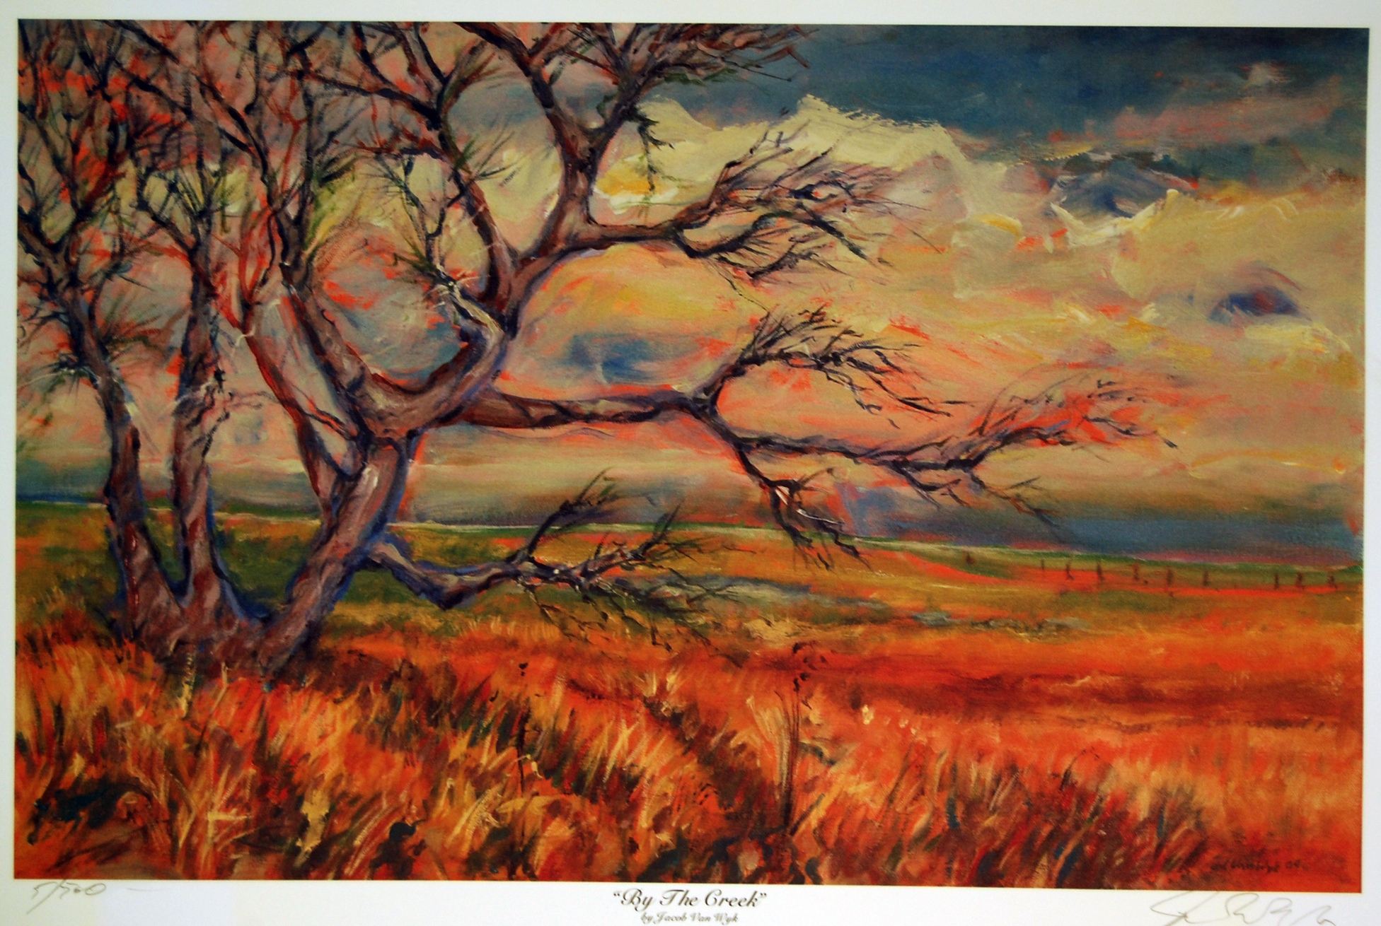

Slide 15
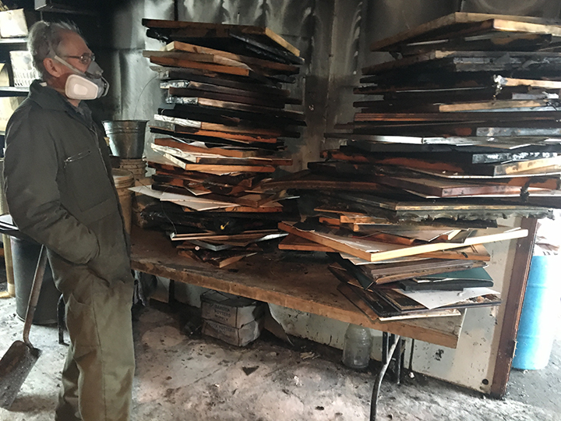

Slide 17
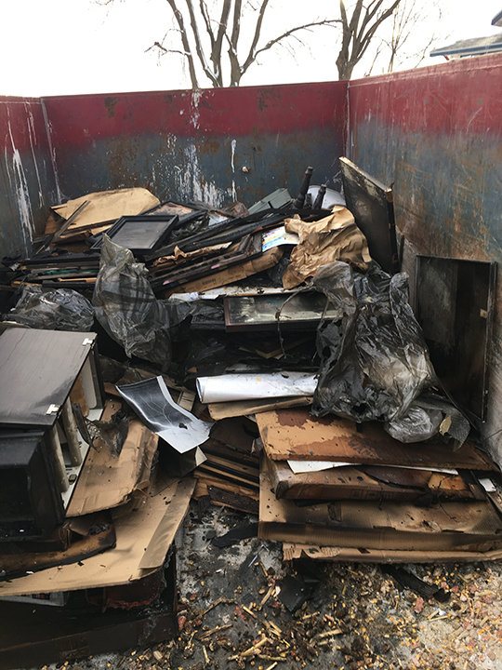

Slide 18
Smoke damaged clay work – some could be cleaned to a degree

Slide 19
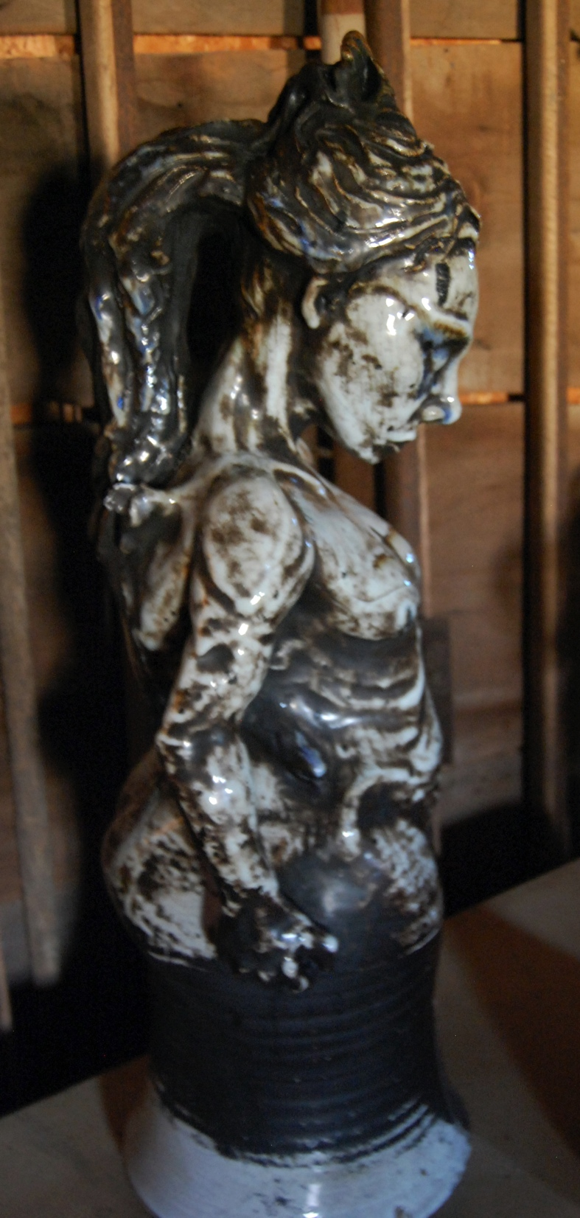
The Curse, clay work from 2004, after fire and cleaning with sos pad

Slide 20
Extent of smoke damage in walls, farthest from fire sourse

Slide 21
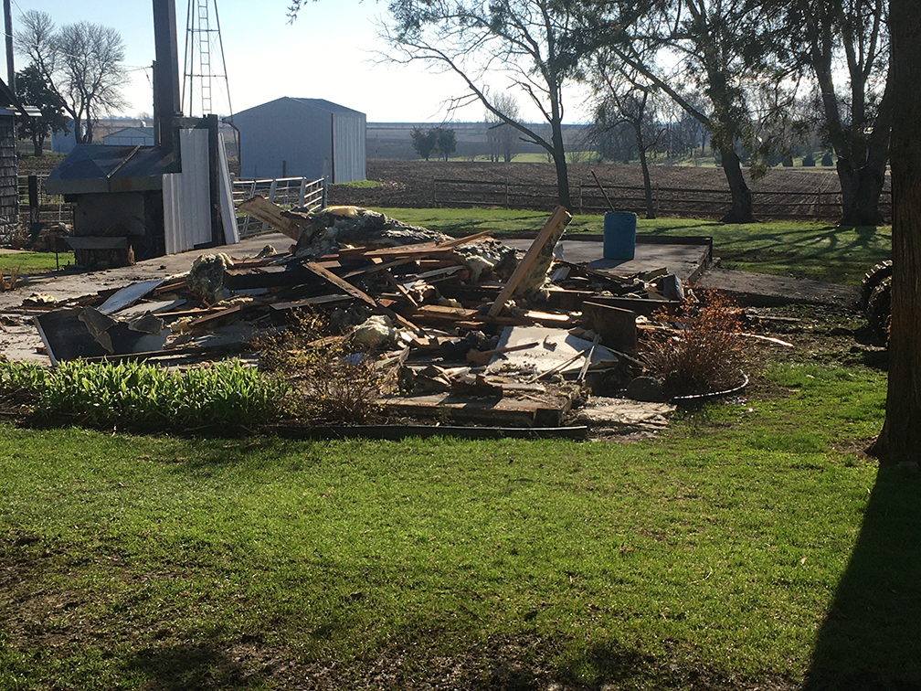
Final day of building removal after 4 months of clearing out

Slide 22
Silver Linings
Art behind glass and underneath stacks could be saved. Lost work came to light.
Apocalyptic Vision – 42 best works were on display at Mount Marty College
Support came from many people and places; prayers and financial support
20 crates of glazed ware in century barn
Insurance claims, GoFundMe account, and other sales and funds for a new building

Slide 23
Apocalyptic Vision display at Northwestern College, 2018

Slide 24
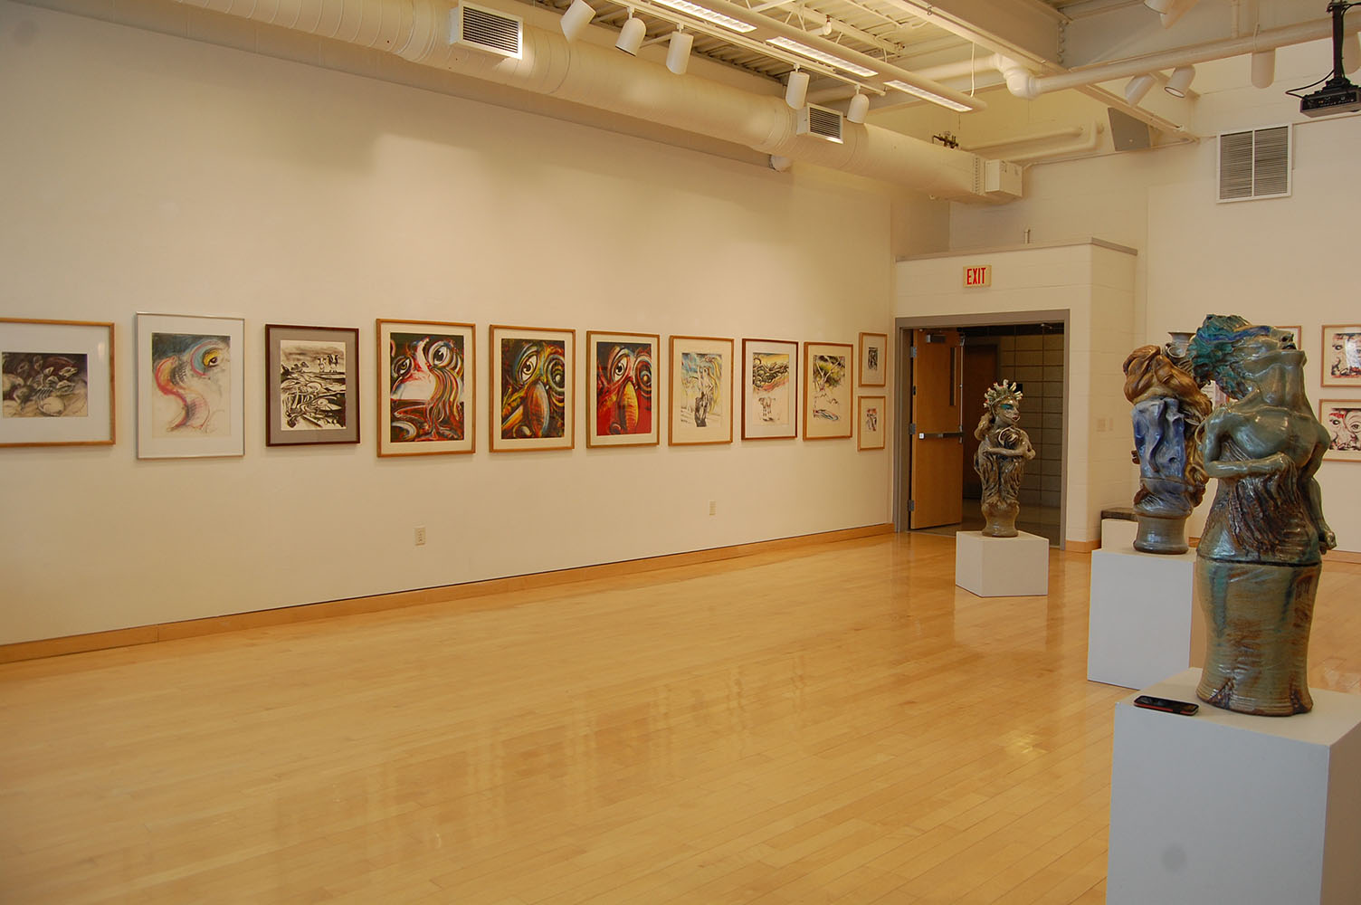

Slide 25
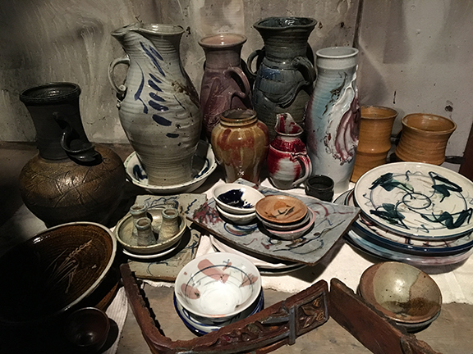
Clay works that could be cleaned

Slide 26
Original Sin, oil painting from 2004, part of Apoc. V. show. Buried on bottom of a pile of art portfolios, saved!

Slide 27
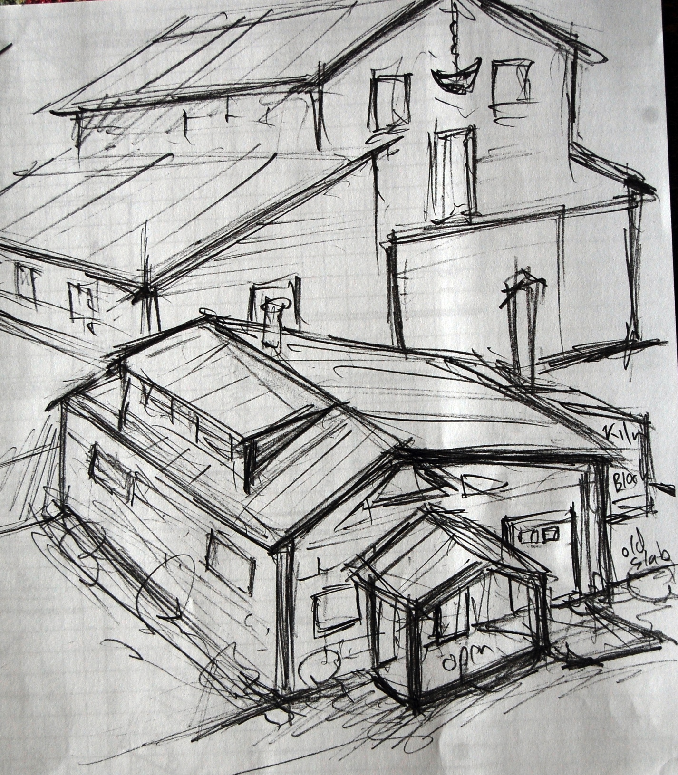
Original sketch
Initial rough sketch of a
Proposed studio, shown in
front of the Century Barn

Slide 28
North Carolina studio, built in 1982, sold to fund new building

Slide 29
New building under construction by PR Builders, Ireton.

Slide 31
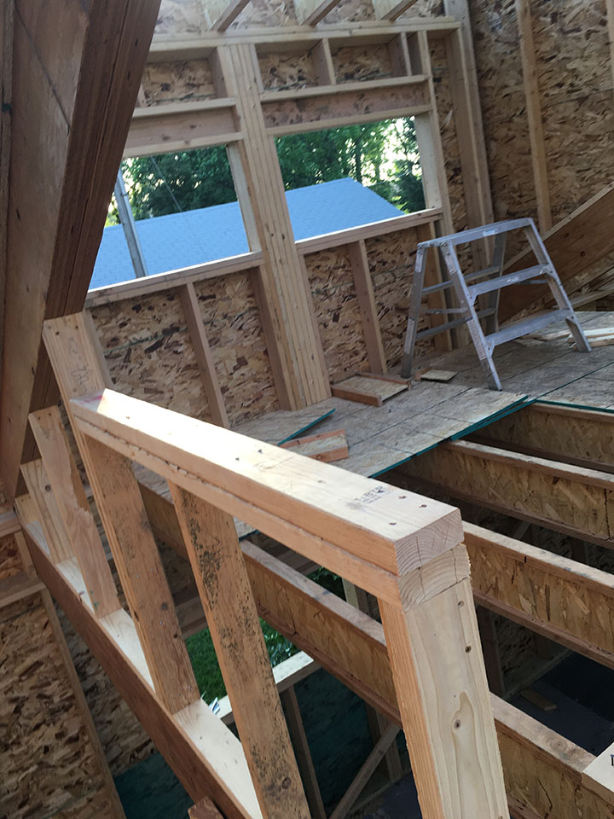

Slide 33
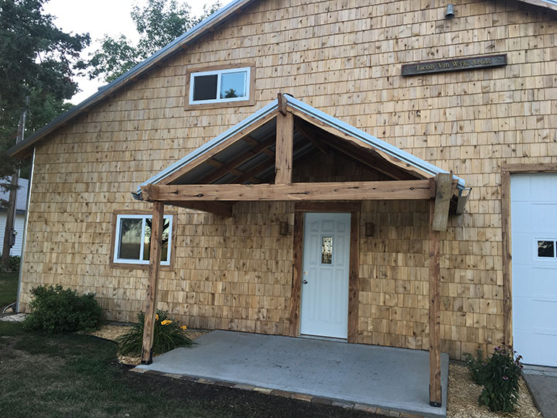
Finished exterior, with porch supports of cedar material from Van Wyk farm

Slide 34
Future exhibit- samples- Out of the Fire - 5 decades – Dordt, Jan. 2021

Slide 37
Heritage – grave rubbings, Oil Pas- tel and graphite, 1995, Netherlands Plumb Line – self porrtrait, graphite pencil, 1979 It Hasn’t Rained like this since 53 graphite pencil, 1981 Yesterday’s Tulips – Oil Pastel and graphite – 1995 , Netherlands next slide – The North Sea –Oil Pastel and graphite – 1995, Nether- lands

Slide 39
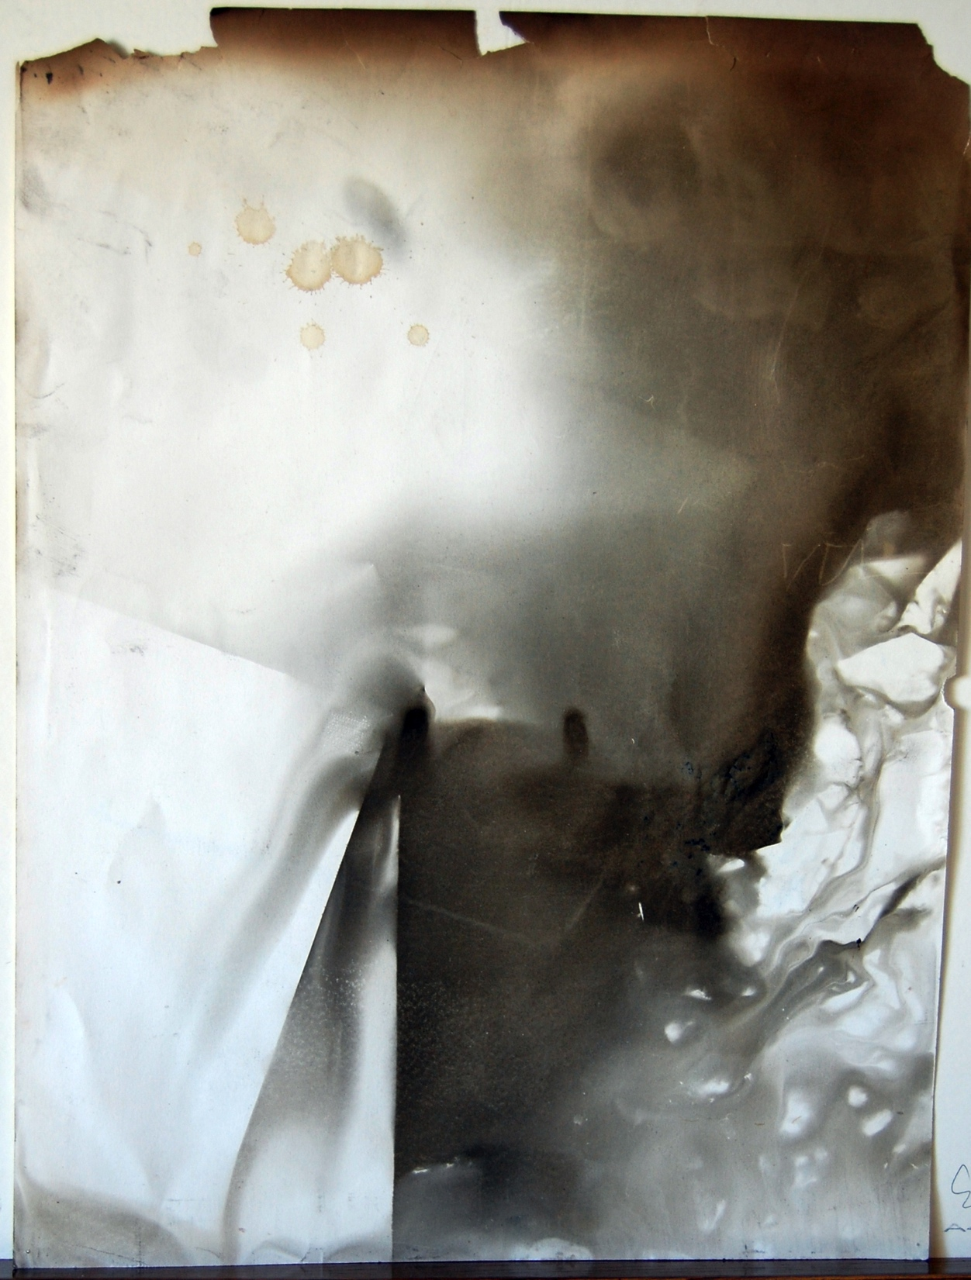
Backs of drawings; created by Smoke. Better images than original drawings

