Slide 1
Apocalyptic Vision
An art exhibit featuring images of the mystery of angelic presence, contemplation of life / death, and biblical end times by Jacob Van Wyk

Slide 2
Notwithstanding the popular images of Angels, I have never dreamt about, nor pre-visualized them; they develop in the process of making images with themes of terrible apparitions and mysterious beings. They are female for me and the emphasis is of course, the eyes. My longstanding love for and interest in the landscape also manifests itself in many images, its metaphorical power and mystery. Recently, I’ve been intrigued by the visionary biblical accounts of end times; beasts and angels, metaphors for God’s mysterious presence and revelation with his people and the transcendental nature of symbolic imagery and awful spiritual power.

Slide 3
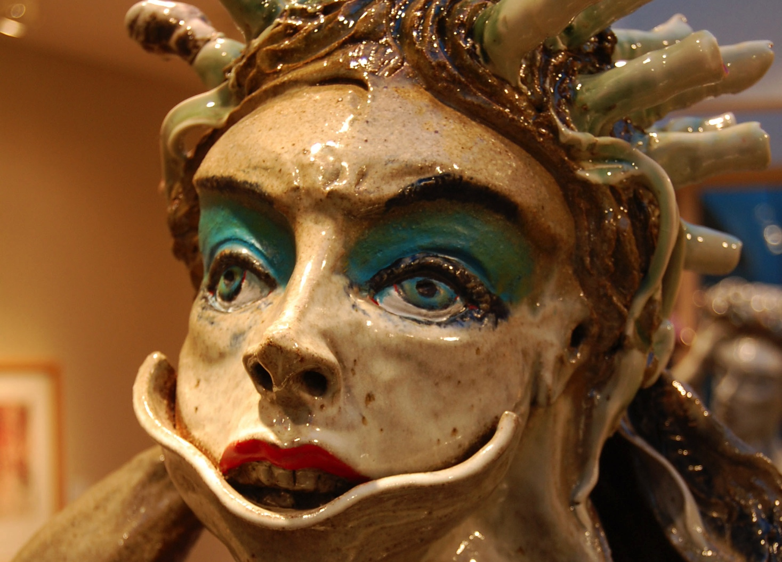
Media
Art Work in oil pastel drawing, graphite, lithographic prints from stone, oil painting and stoneware clay sculpture dated from 1984 through the
present.

Slide 4
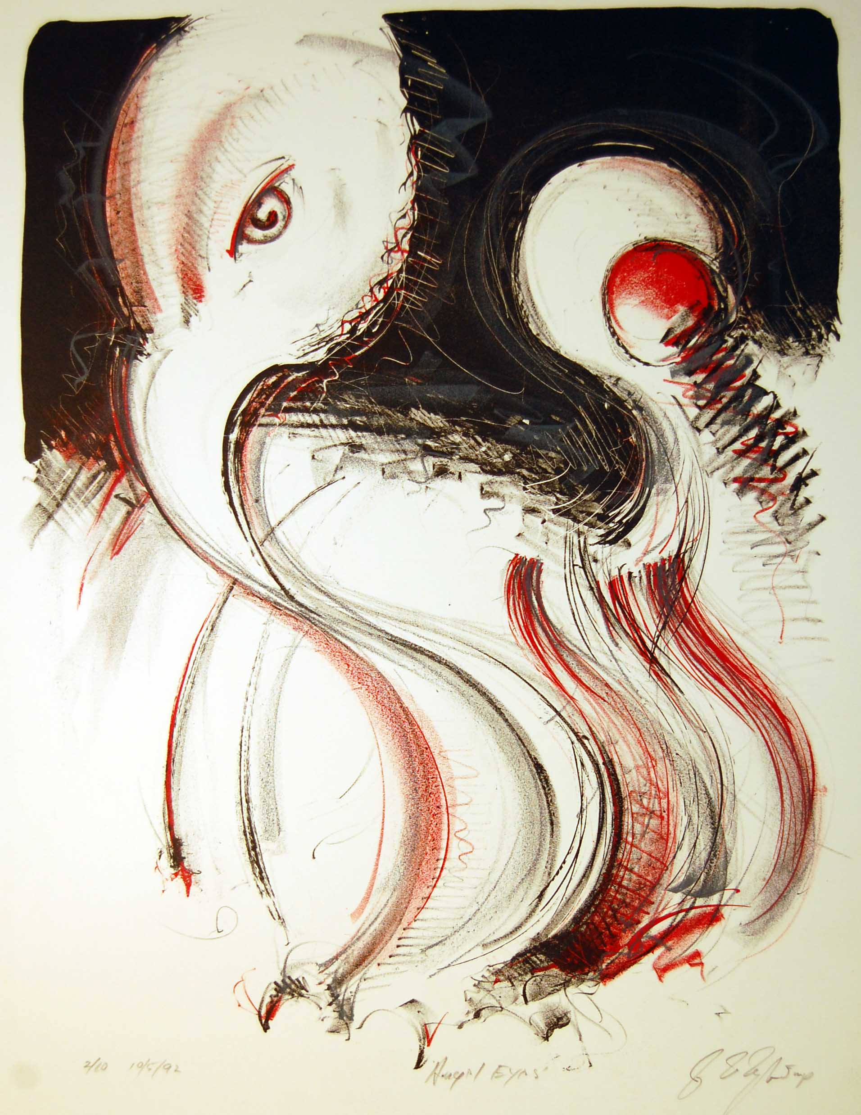
Angel Eyes – a long term study in Angelic Presence

Slide 5
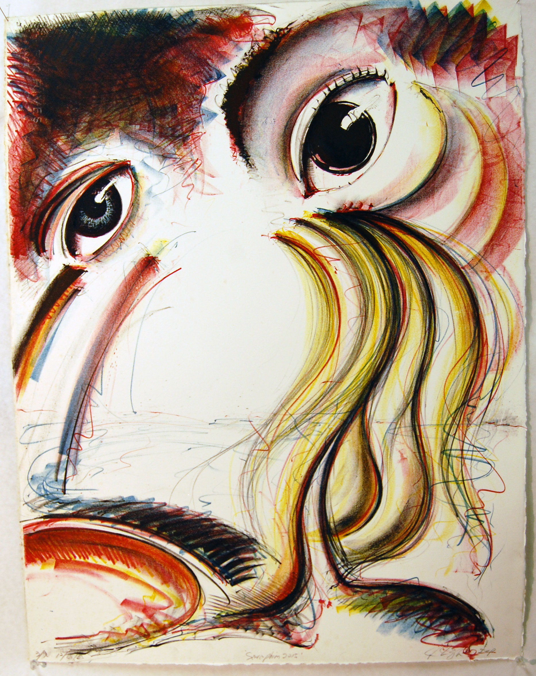
Seraphim – monoprint 1995 Seraphim 2015

Slide 6
The Great I Am Mono-print litho 1995

Slide 7
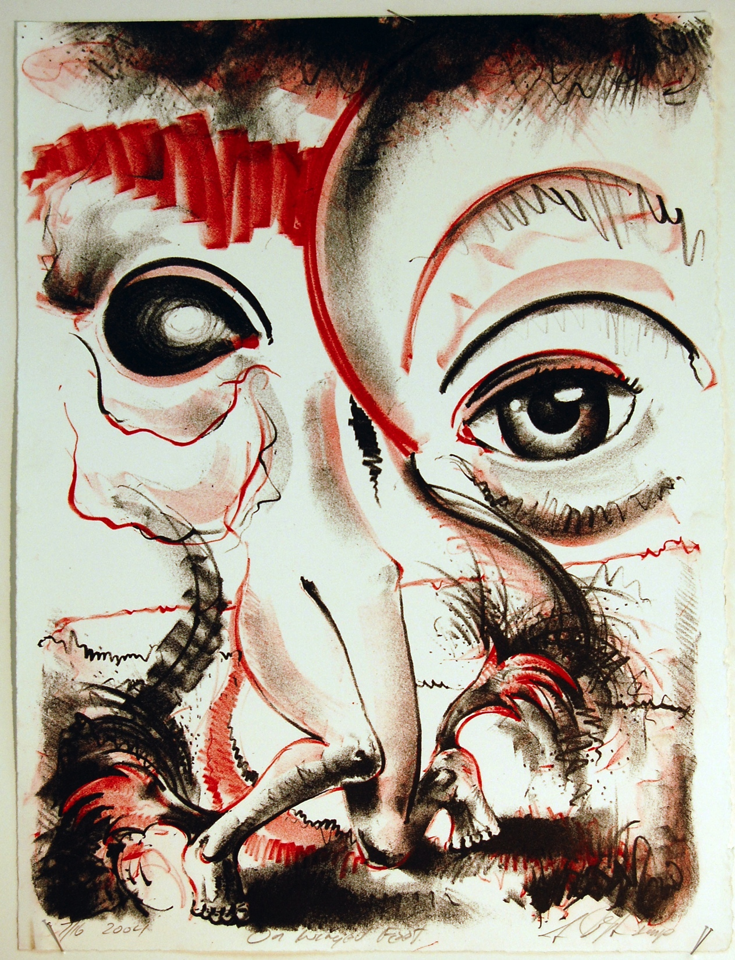
From Pitch and Roll, a nationally known print portfolio, came the 2 color series of Angel prints in 2004

Slide 8
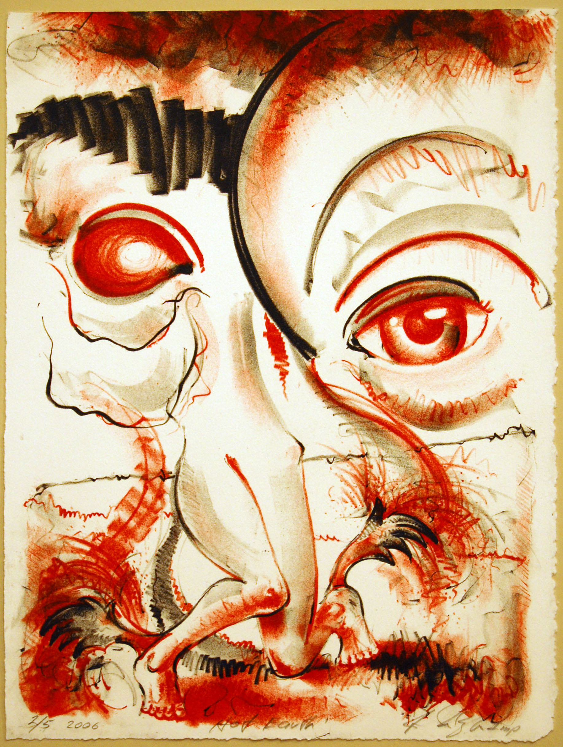

Slide 9
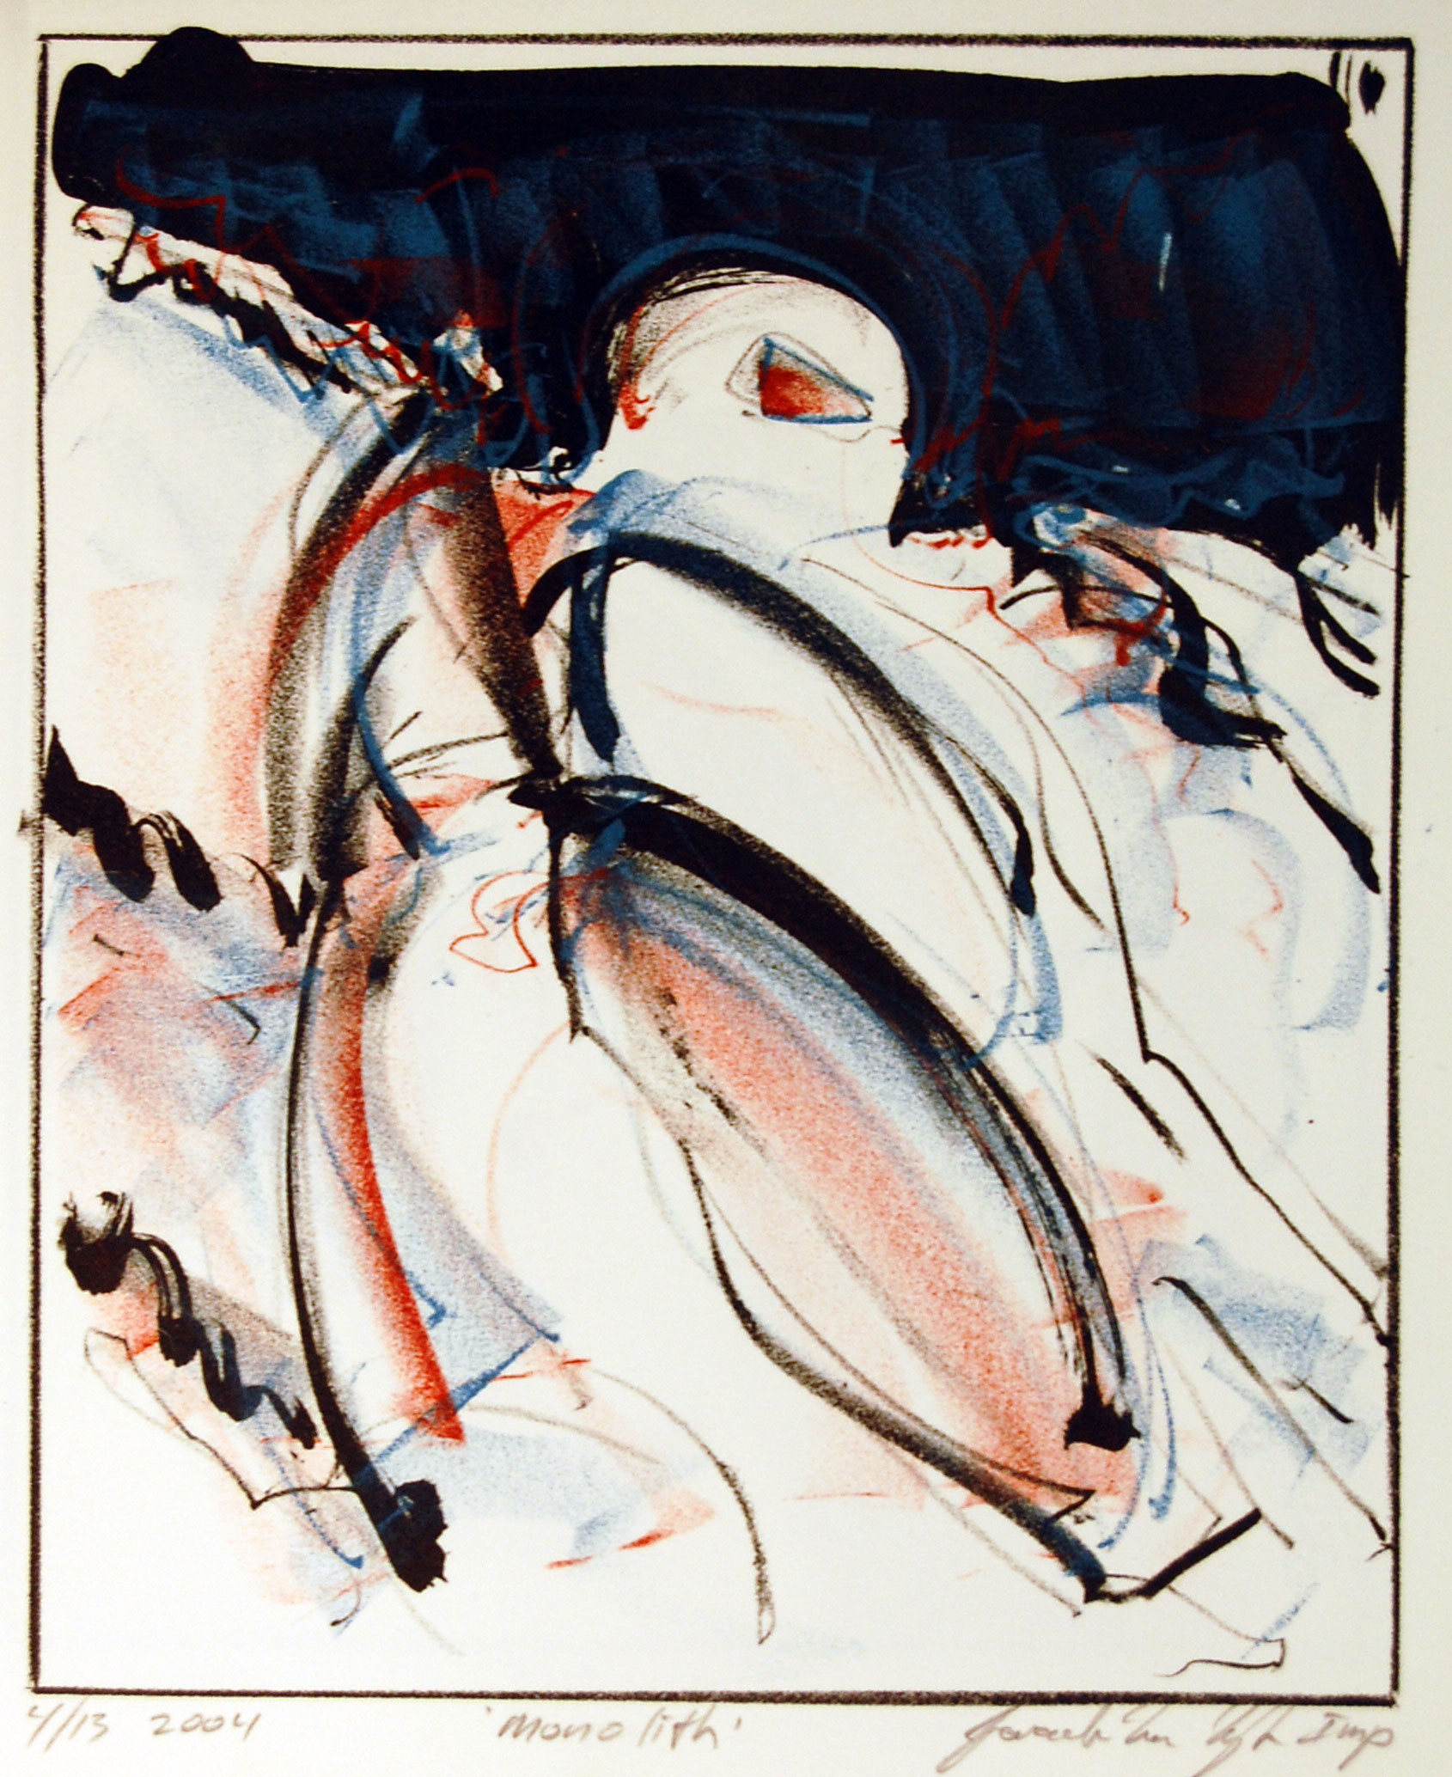
Sometimes the figures are anthropomorphic, lithos 2003

Slide 10
Other figures are animals, metaphors for human contemplation of life, and . . . death. Fat Rat Dreams 1984

Slide 11
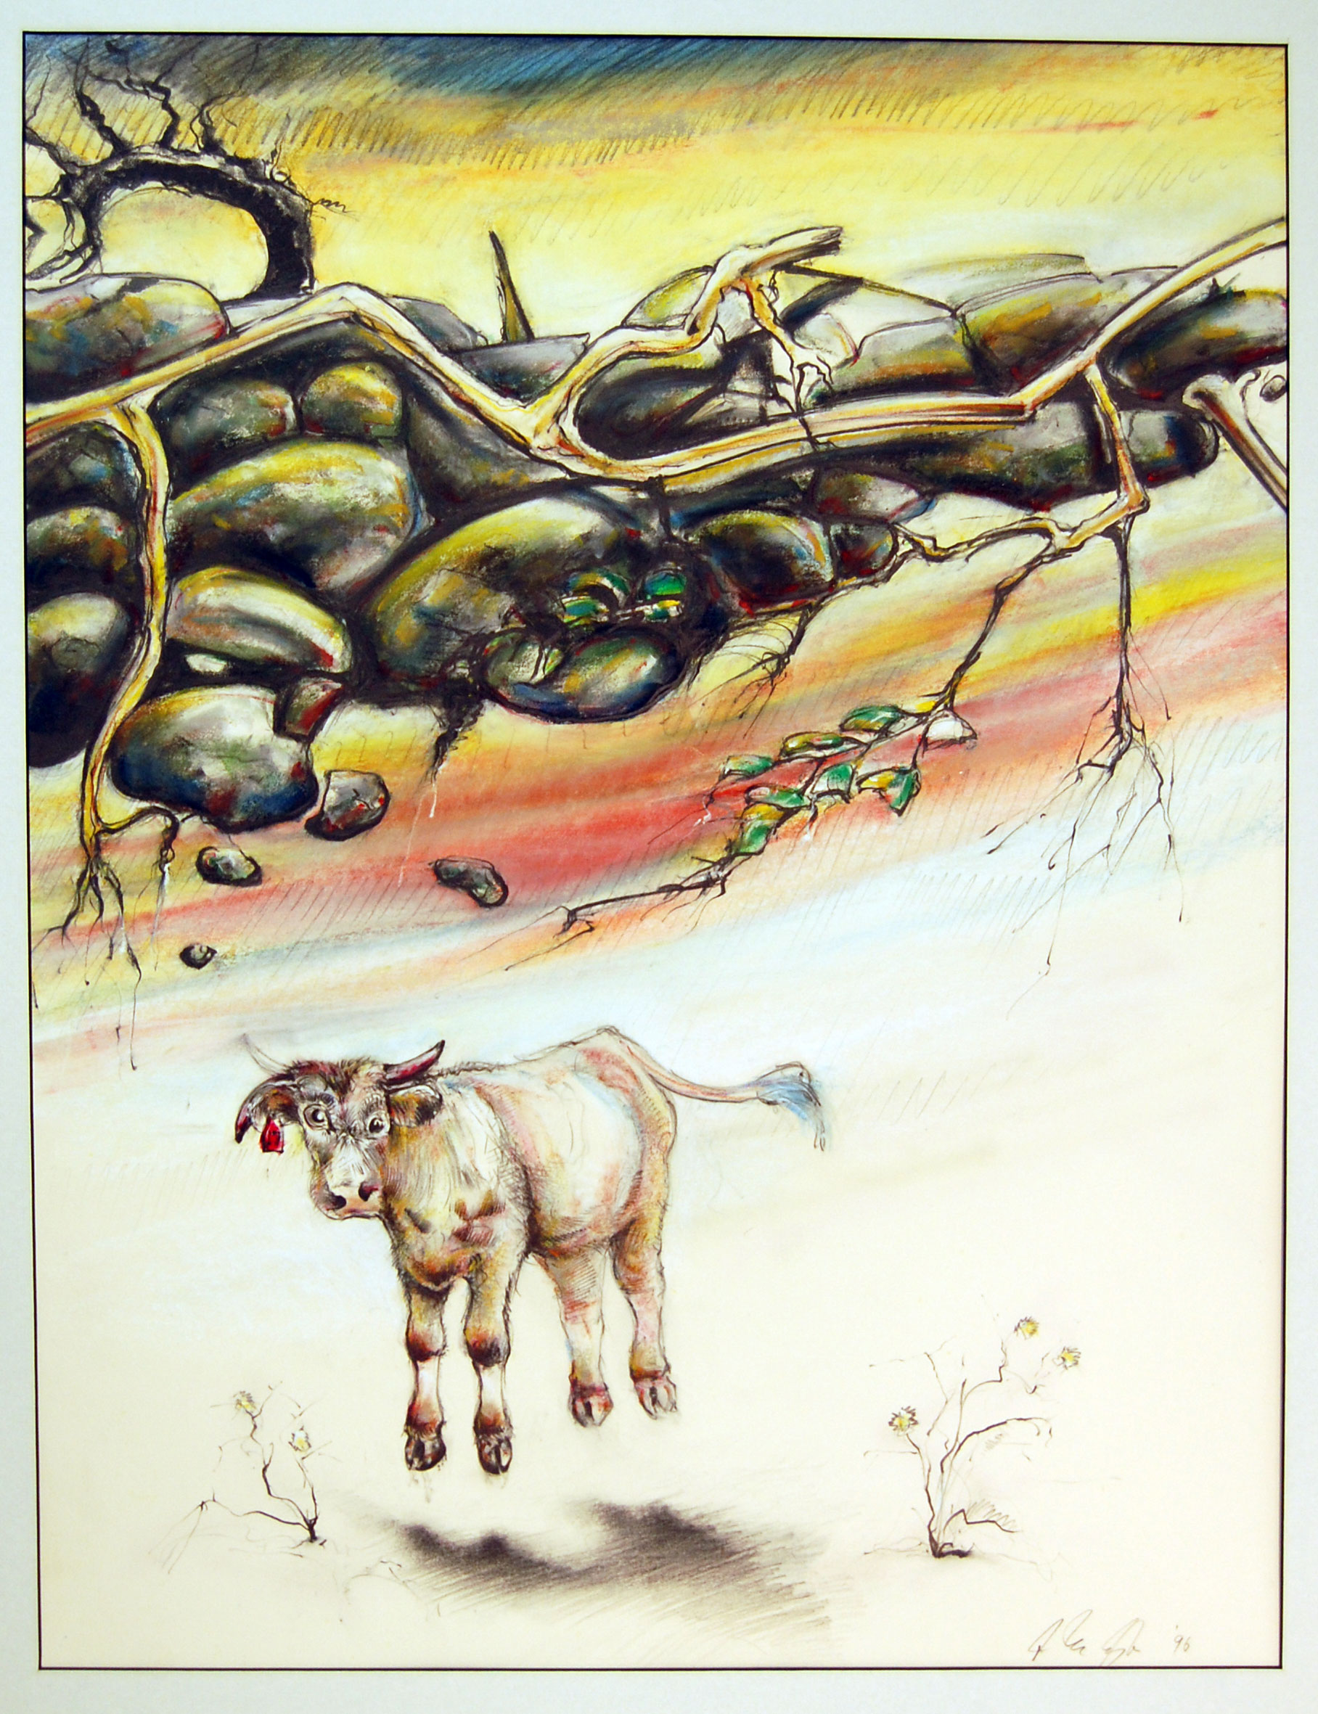
Scrape the Pen 1994 Suspended Sentence 1996

Slide 12
Spring of Life 1996 Oil pastel and pencil

Slide 13
Sabatine 1998 Oil pastel and pencil

Slide 14
The Mackerel Sky 1999 mixed media drawing a requiem for my father and commentary on death

Slide 15
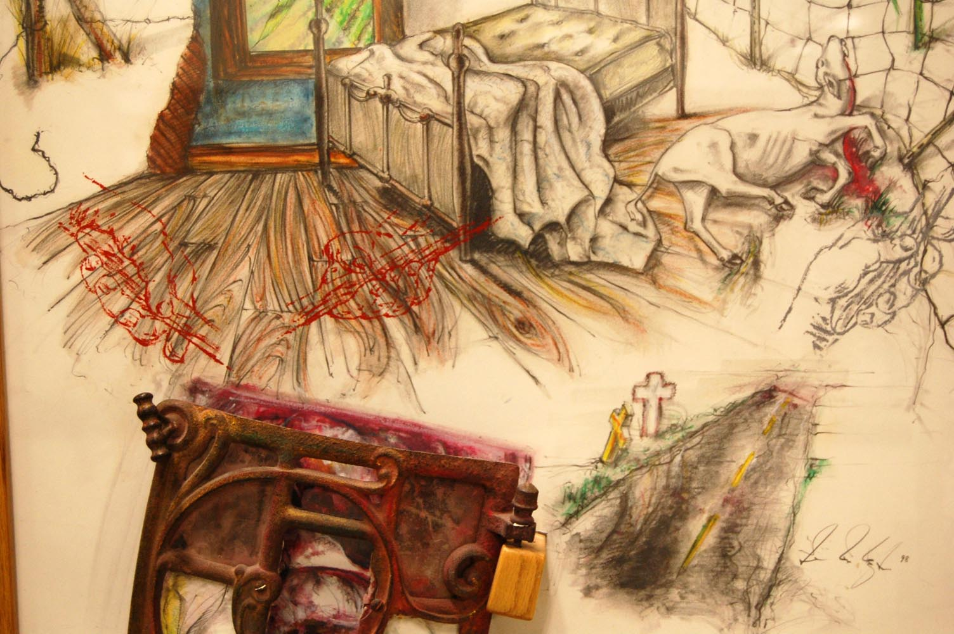
detail – floor, silk screened hands

Slide 16
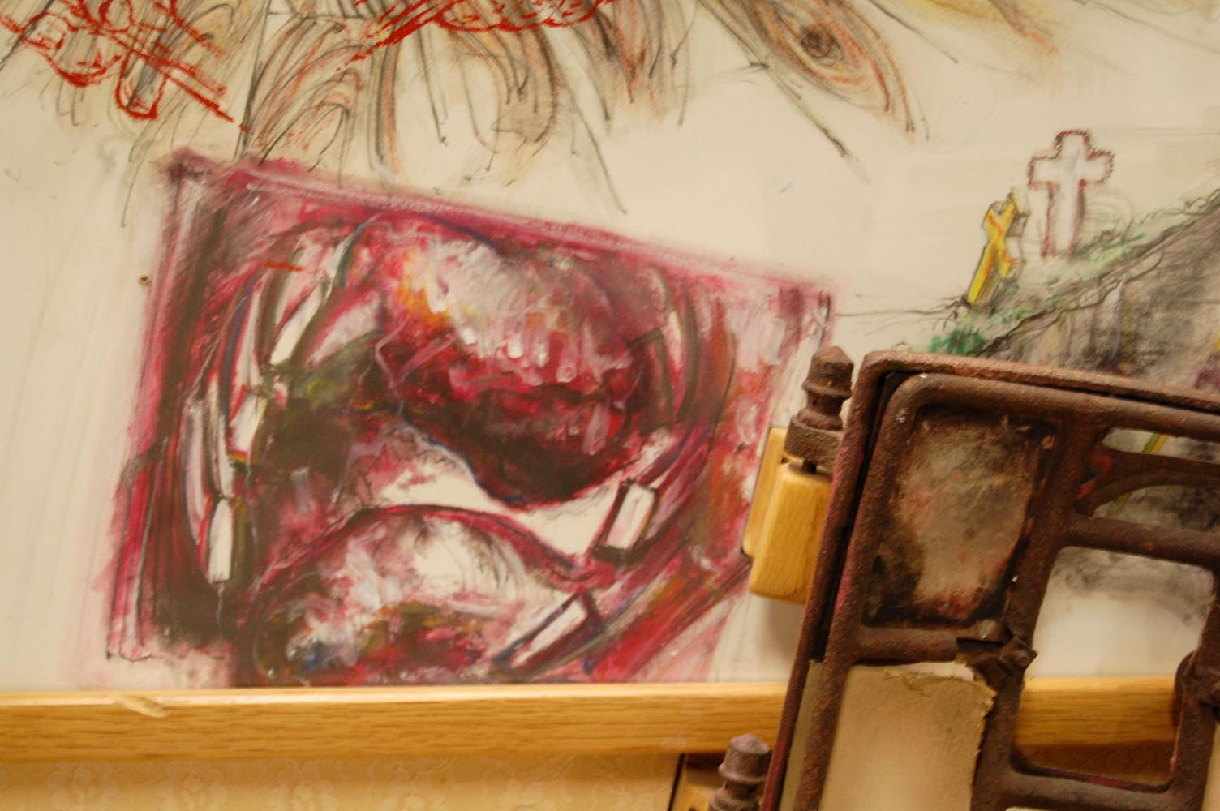
detail – behind stove door

Slide 17
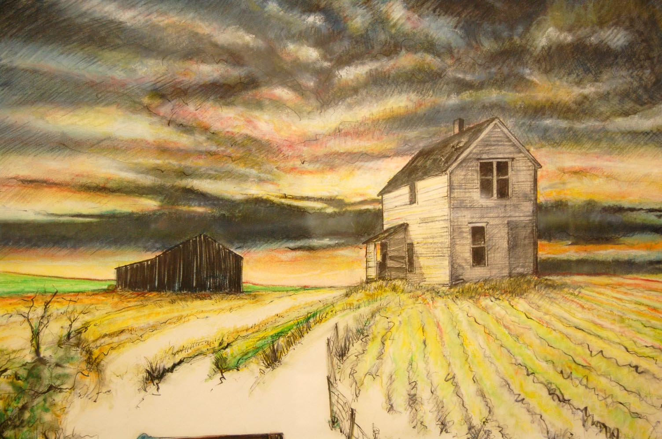
detail – sky / buildings

Slide 18
Oil painting - abstract landscapes - Palette Series 2004

Slide 19
Original Sin 2004

Slide 20
Landscape in a Dream 2009 inspired by Roberto Matta who coined the term; Psychic Automatism

Slide 21
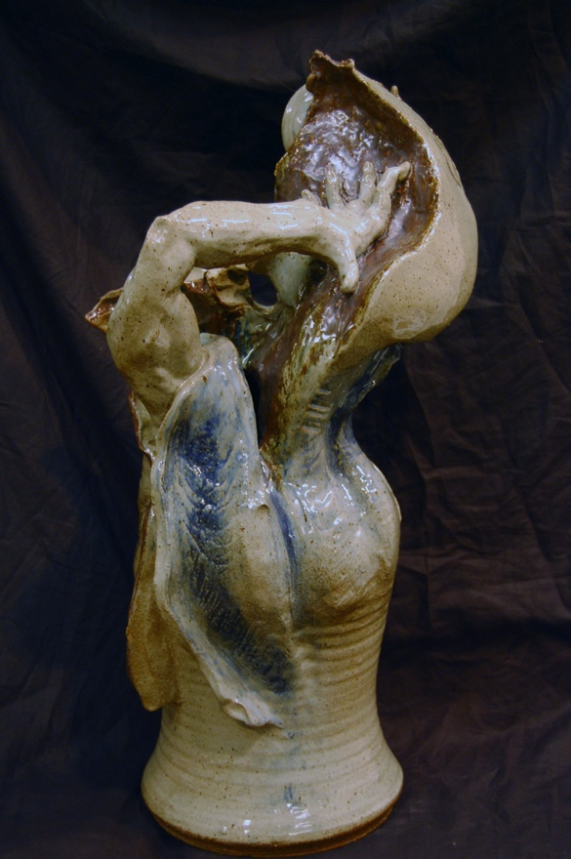
Clay sculpture – figurative / biblical – Transformation 2004

Slide 22
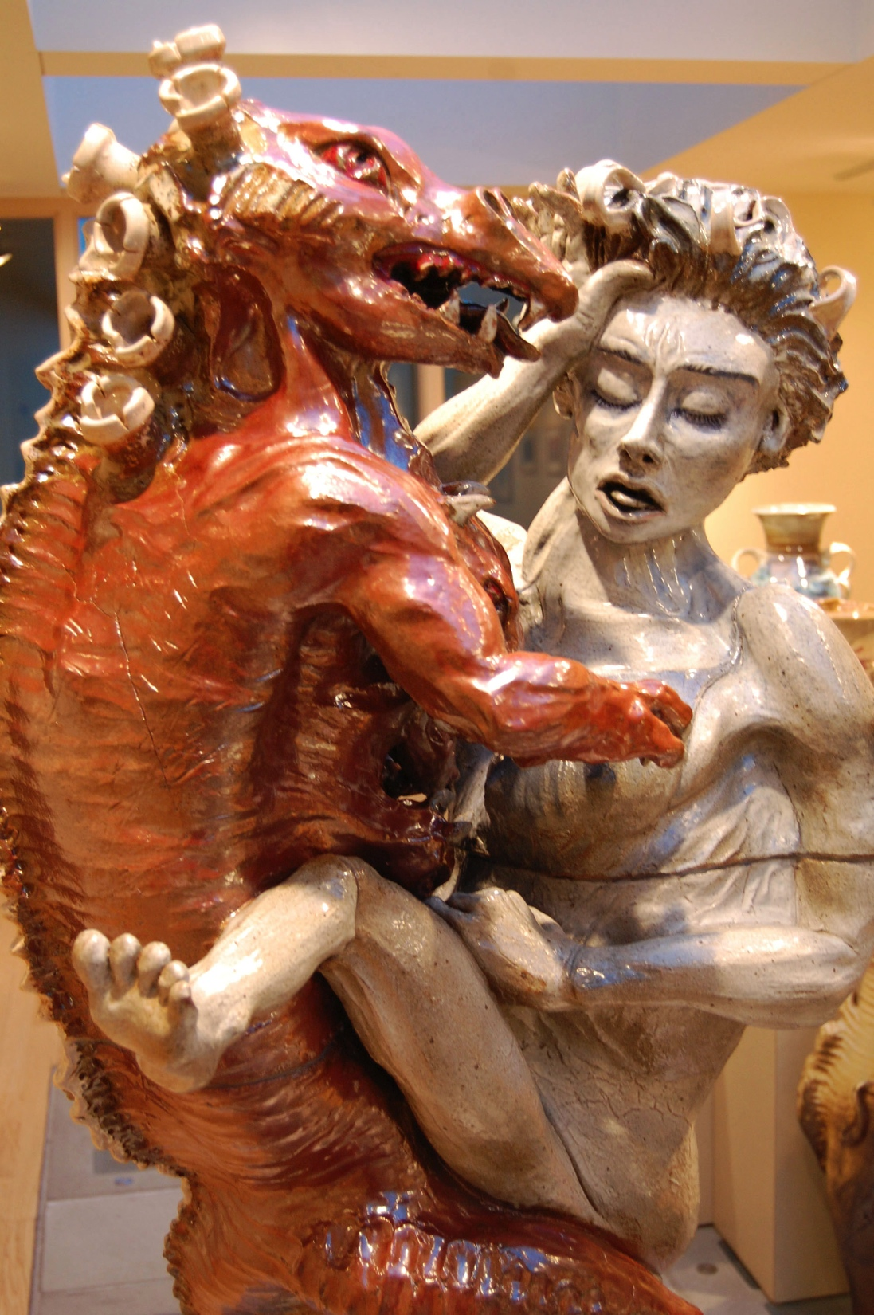
From the Angel / Beast exhibit 2014

Slide 23
Angel/Beast Exhibit – Dordt College, November, 2013

Slide 24
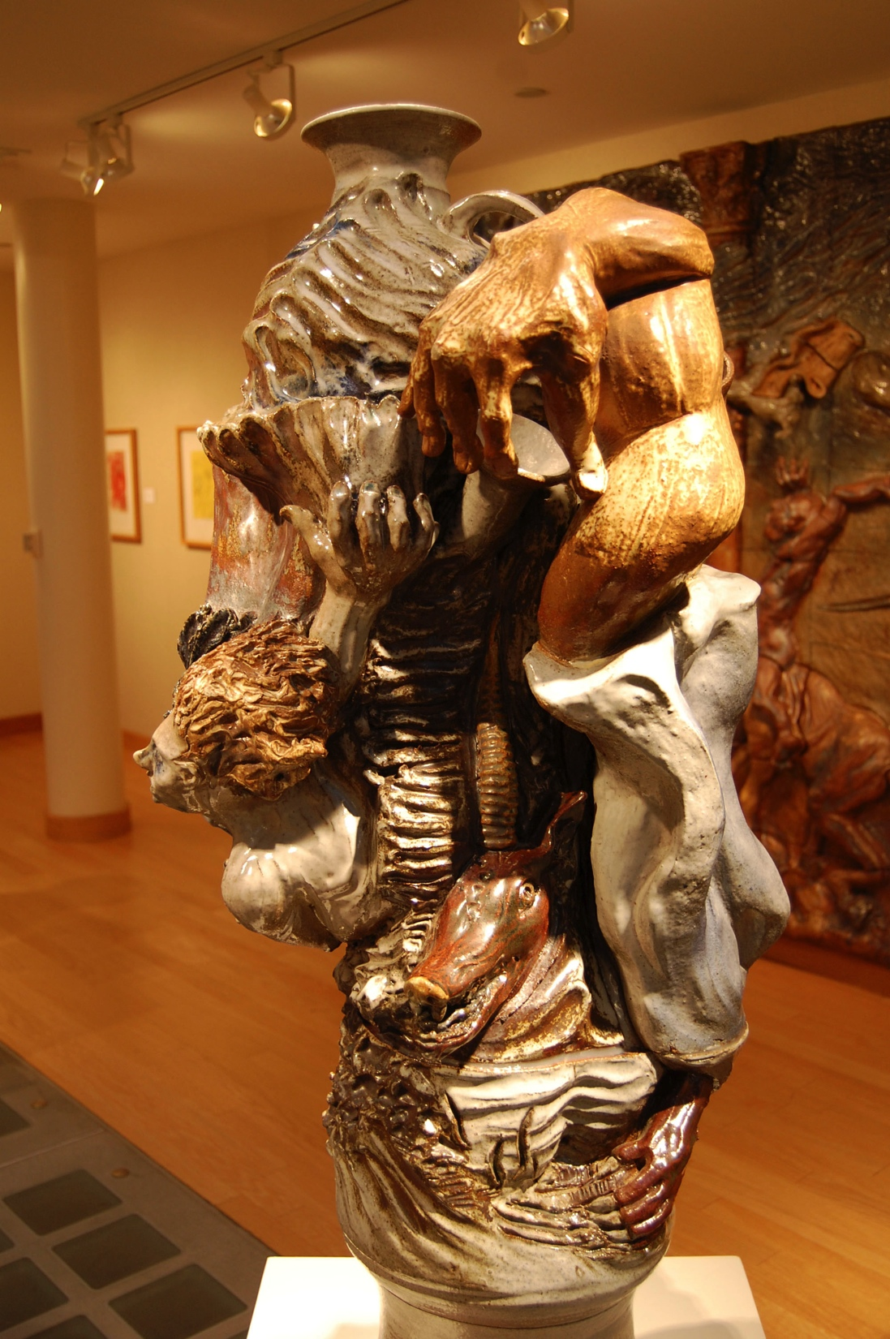
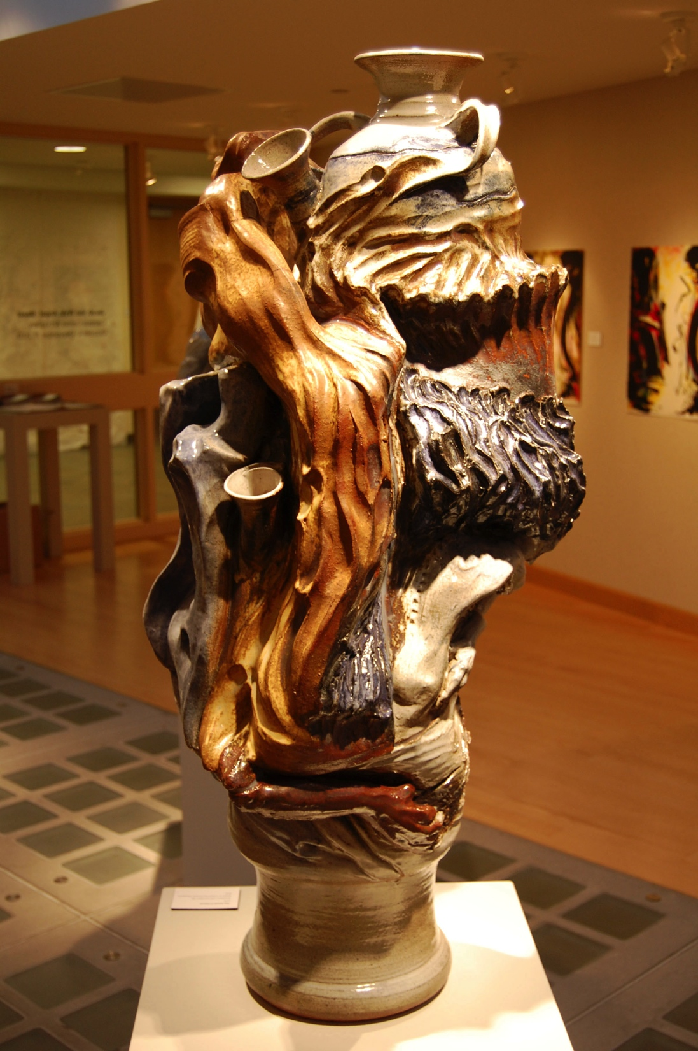
The Hound of Heaven after a story by Francis Thompson

Slide 25
The Coming – 8’ by 12’ tableau

Slide 27
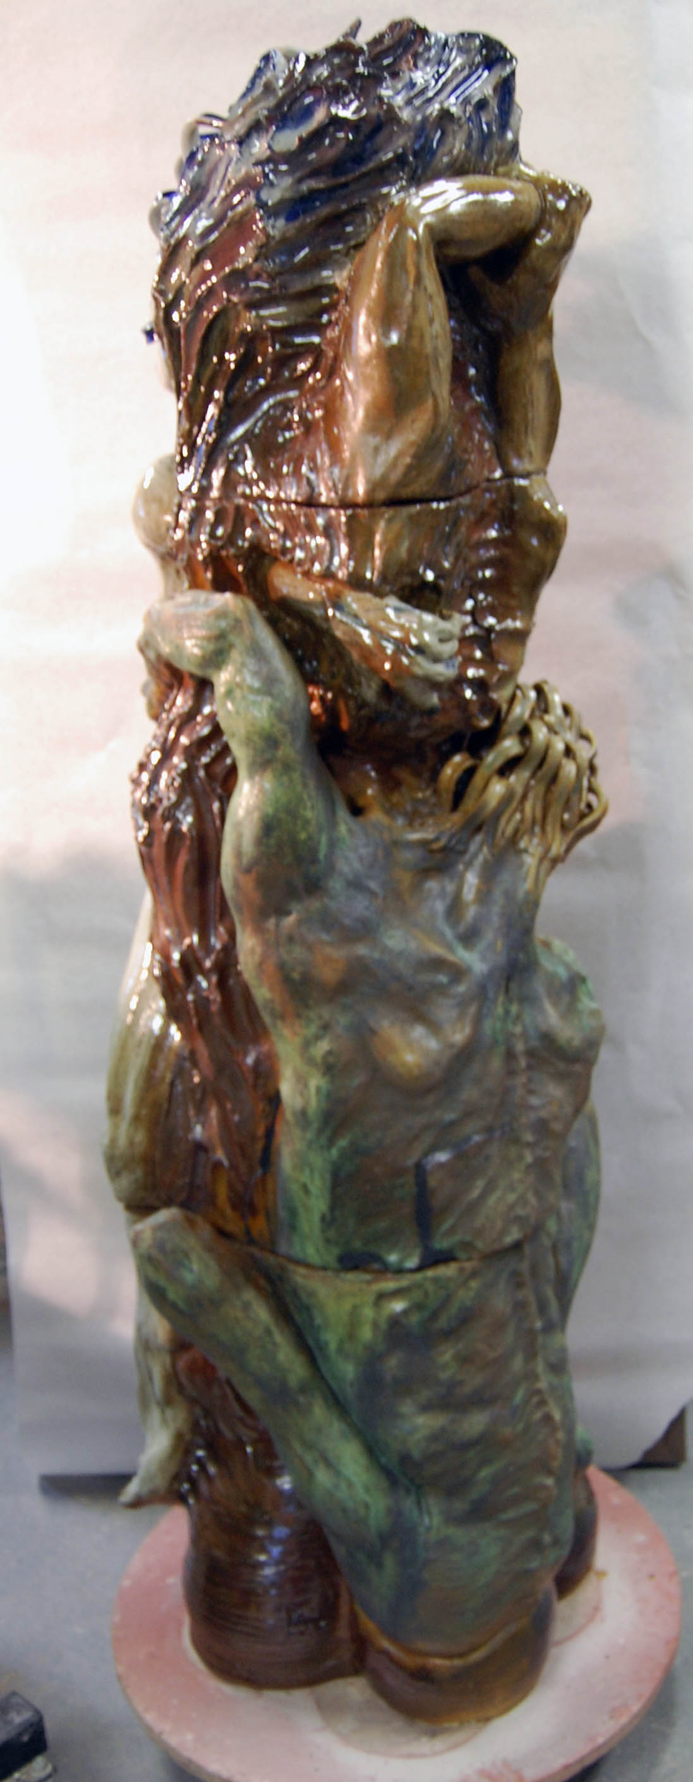
Submission 2017 – 5ft tall, 485 lbs

Slide 28
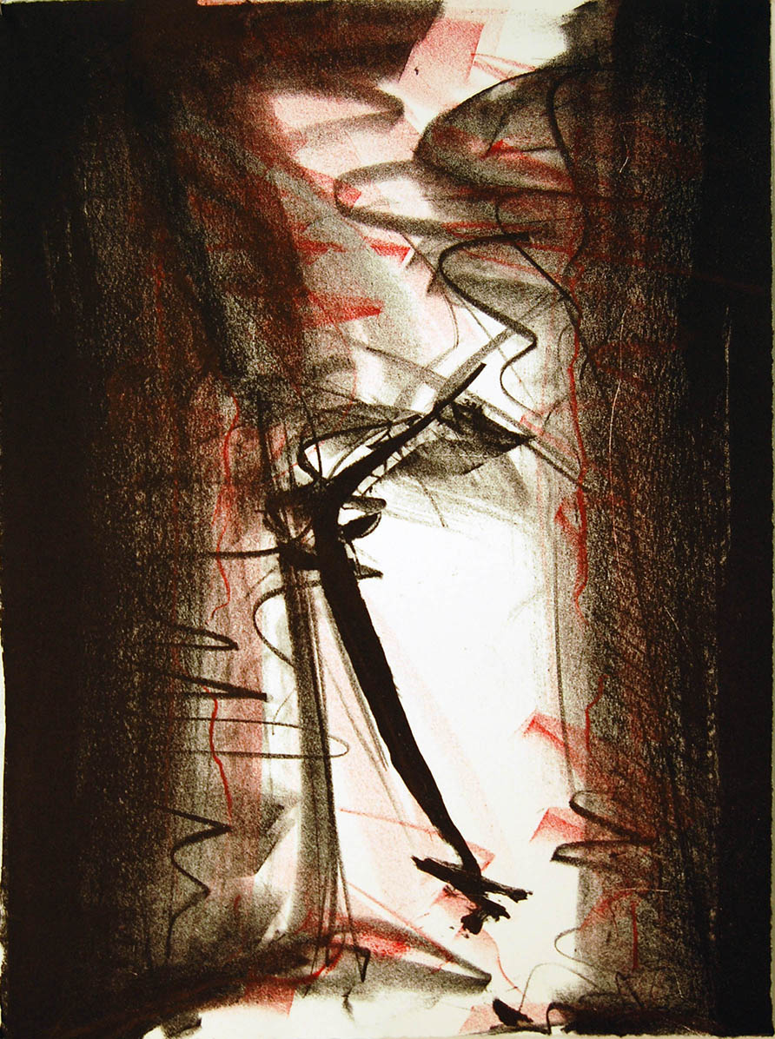
Lithographs 2015 The Red Curtain – The Gates of Hell

